Slide 1
Session 2
Control flow statements
Operators, Conditional statement, For loop

Slide 2
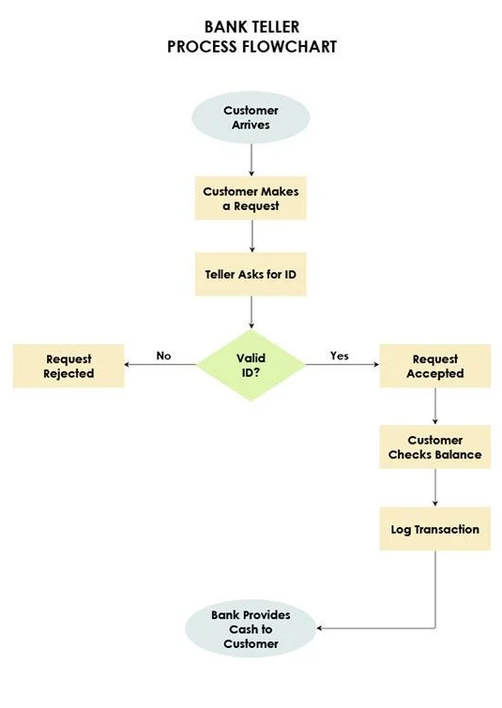
Control flow statements
Operators are symbols that perform specific operations on operands (variables or values). This is used for performing calculations, comparisons, and other operations in your programs.
Conditional statements are essential for making decisions in programs
Loops for repeating tasks efficiently.

Slide 3
1. Arithmetic Operators:
Arithmetic operators are used to perform basic mathematical calculations.
`+` (Addition): Adds two operands.
`-` (Subtraction): Subtracts the right operand from the left operand.
`*` (Multiplication): Multiplies two operands.
`/` (Division): Divides the left operand by the right operand.
`%` (Modulus): Returns the remainder after division.

Slide 4
2. Relational Operators:
Relational operators are used for comparisons and return a boolean result (`true` or `false`).
`==` (Equal to): Checks if two operands are equal.
`!=` (Not equal to): Checks if two operands are not equal.
`>` (Greater than): Checks if the left operand is greater than the right operand.
`<` (Less than): Checks if the left operand is less than the right operand.
`>=` (Greater than or equal to): Checks if the left operand is greater than or equal to the right operand.
`<=` (Less than or equal to): Checks if the left operand is less than or equal to the right operand.

Slide 5
3. Logical Operators:
Logical operators are used to perform logical operations and return a boolean result.
`&&` (Logical AND): Returns `true` if both operands are true.
`||` (Logical OR): Returns `true` if at least one of the operands is true.
`!` (Logical NOT): Returns the opposite boolean value of the operand.

Slide 6
4. Assignment Operators:
Assignment operators are used to assign values to variables.
`=` (Assignment): Assigns the value on the right to the variable on the left.
`+=`, `-=`, `*=`, `/=`, `%=` (Compound Assignment): Performs the corresponding arithmetic operation and assigns the result to the variable.

Slide 7
5. Increment and Decrement Operators:
Increment and decrement operators are used to increase or decrease the value of a variable by 1.
`++` (Increment): Increases the value of the variable by 1.
`--` (Decrement): Decreases the value of the variable by 1.

Slide 8
package com.basic;
/* Operators are symbols that perform operations on variables and values.
* Java supports various types of operators, including arithmetic, relational, logical, and assignment operators. */
public class Operators {
public static void main(String[] args) {
int a = 10;
int b = 5;
// Arithmetic Operators
int sum = a + b; // Addition
int difference = a - b; // Subtraction
int product = a * b; // Multiplication
int quotient = a / b; // Division
int remainder = a % b; // Modulus (remainder of division)
// Relational Operators
boolean isEqual = (a == b); // Equality check
boolean isNotEqual = (a != b); // Not equal check
boolean isGreater = (a > b); // Greater than check
boolean isLess = (a < b); // Less than check
// Logical Operators
boolean logicalAnd = (a > 0 && b > 0); // Logical AND
boolean logicalOr = (a > 0 || b > 0); // Logical OR
boolean logicalNot = !(a > 0); // Logical NOT
// Assignment Operators
a += b; // Equivalent to a = a + b;
a -= b; // Equivalent to a = a - b;
a *= b; // Equivalent to a = a * b;
a /= b; // Equivalent to a = a / b;
a %= b; // Equivalent to a = a % b;
//increment and decrement operators
a++;
-–b;
}
}

Slide 9
Conditional Statements
Conditional statements allow a program to make decisions based on certain conditions.
In Java, we have three main types of conditional statements: if, else if, and else.
if statement: The if statement is used to execute a block of code only if a given condition is true.
int age = 18;
if (age < 18) {
System.out.println("You are a child");
}

Slide 10
else if statement:
The else if statement provides an alternative condition to check if the initial if condition is false.
int score = 85;
if (score >= 90) {
System.out.println("Excellent!");
} else if (score >= 80) {
System.out.println("Good job!");
} else if (score >= 70) {
System.out.println("Keep it up!");
} else {
System.out.println("You can do better!");
}

Slide 11
else statement
The else statement is used when none of the previous conditions are true.
int hour = 14;
if (hour < 12) {
System.out.println("Good morning!");
} else {
System.out.println("Good afternoon!");
}

Slide 12
Conditional Example
package com.conditional;
public class ConditionalExample {
public static void main(String[] args) {
int a = 5;
int b=10;
if(a>b) {
System.out.println("A is greater");
}else if (a ==b) {
System.out.println("A equal to B");
}else {
System.out.println("B is greater");
}
}
}

Slide 13
For Loops:
For loops allow us to repeat a block of code for a specific number of times. This is useful for performing repetitive tasks in a program.
a) Basic for loop: The basic for loop has three parts: initialization, condition, and increment/decrement.
for (int i = 1; i <= 5; i++) {
System.out.println("This is loop iteration #" + i);
}

Slide 14
Enhanced for loop (for-each): The enhanced for loop is used to iterate over elements in an array or a collection.
int[] numbers = {1, 2, 3, 4, 5};
for (int num : numbers) {
System.out.print(num + " ");
}

Slide 15
Nested for loops
You can also use for loops inside each other for more complex iterations.
for (int i = 1; i <= 3; i++) {
for (int j = 1; j <= 3; j++) {
System.out.println("i: " + i + ", j: " + j);
}
}

Slide 16
Loop example
package com.loop;
public class ConditionalLoopExample {
public static void main(String[] args) {
int sum = 0;
// For loop to calculate the sum of the first 5 even numbers
for (int i = 1; i <= 10; i++) {
if (i % 2 == 0) { // Check if the number is even
sum += i; // Add the even number to the sum
}
}
// Print the result
System.out.println("The sum of the first 5 even numbers is: " + sum);
}
}

Slide 17
Key concepts
Operators
Java operators perform various operations on operands.
Arithmetic operators handle mathematical calculations.
Relational operators compare values and return true or false.
Logical operators perform logical operations and return true or false.
Assignment operators assign values to variables.
Increment and decrement operators change the value of a variable by 1.
The conditional operator provides a concise way to write if-else statements.
Conditional statements allow us to make decisions in programs based on specific conditions.
For loops help us repeat a block of code for a specific number of times or iterate over elements in an array/collection.

Slide 18
Assigments
Variables:
https://docs.oracle.com/javase/tutorial/java/nutsandbolts/QandE/questions_variables.html
Operators
https://docs.oracle.com/javase/tutorial/java/nutsandbolts/QandE/questions_operators.html

